Slide 1
TIES4911 - Task 2
Kumpulainen Samu
All code at https://colab.research.google.com/drive/1NexTVEs-gGoI3UIggw13_ijoui1kPaan

Slide 2
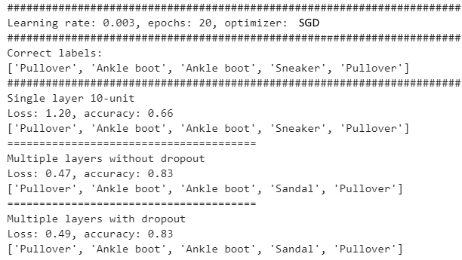
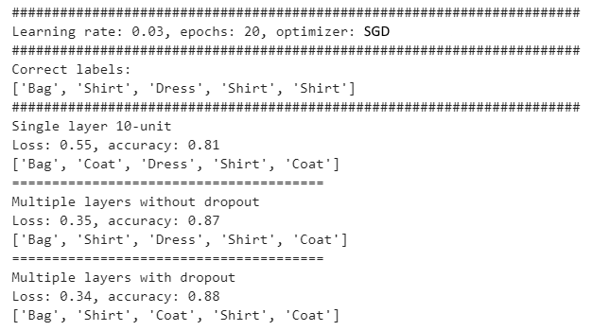
Task 2.1 - Fashion-MNIST comparison
Keras-based solutions
SGD optimizer

Slide 3
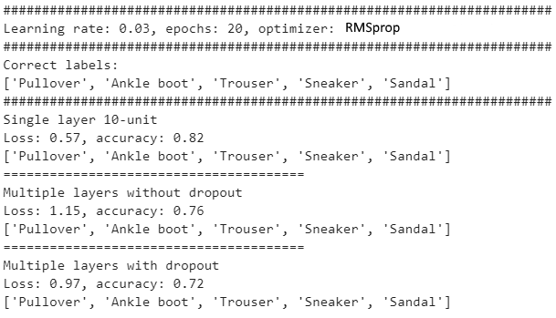
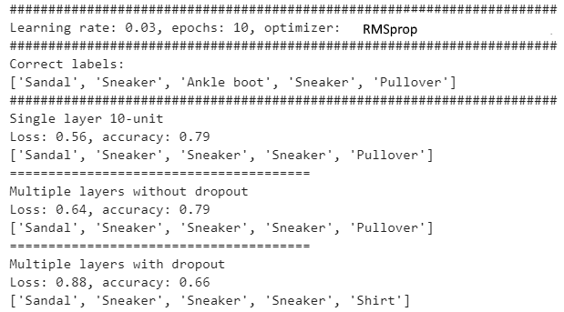
Task 2.1 - Fashion-MNIST comparison
Keras-based solutions
RMSprop optimizer

Slide 4
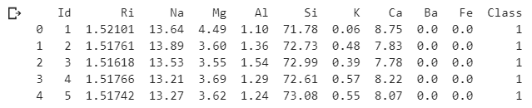
Task 2.2 - Glass classification
Not very accurate
Test accuracy : max 0.45
Average loss : 2.08
Loss: 2.08
Normalization?
Glass Identification Data Set (https://archive.ics.uci.edu/ml/datasets/Glass+Identification)
Multivariate real classification
9(10) variables: (Id), RI,Na, Mg, Al, Si, K, Ca, Ba, Fe amounts
214 items
6(7) classes present
TF2
tf.estimator. DNNClassifier
10, 20, 10 hidden units
8 classes (?)

Slide 5
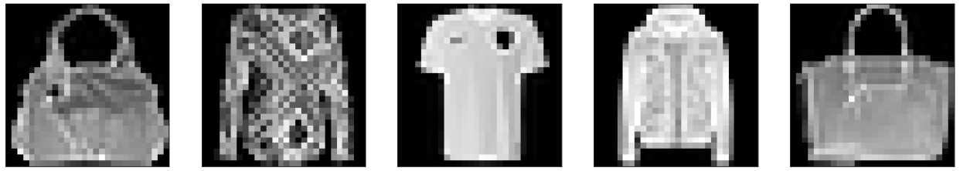
Task 2.3 - Keras comparison
Model training
Single layer 1-unit:
Test loss: 1.87, Test accuracy: 0.22
Multi layer, no dropout:
Test loss: 0.50, Test accuracy: 0.89
Multi layer, with dropout:
Test loss: 0.44, Test accuracy: 0.89
5 item random sample from test set
Usually multi layered models got 1-2 wrong
Correct | Bag | Shirt | T-shirt | Coat | Bag
Single layer | Coat | Coat | Coat | Coat | Coat
Multi layer | Bag | Shirt | T-shirt | Coat | Bag
Multi layer, dropout | Bag | Shirt | T-shirt | Coat | Bag

